Slide 1
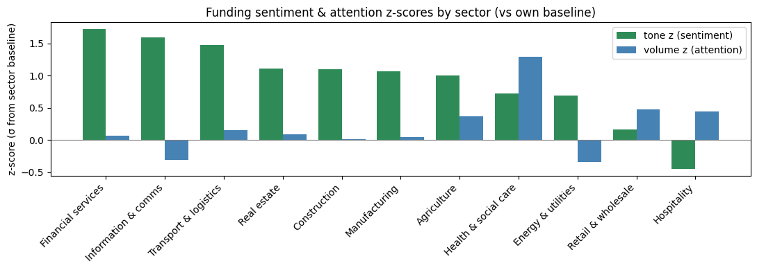
GDELT
What is GDELT?
Global Database of Events, Language, and Tone – massive, open-source database platform that monitors global boradcast, prints and news over 100 languages.
How does it contribute to the project?
timeline tone (sentiment) and timeline volume (coverage) of the news regards the keywords given.
Comparing sector-level tone and volume in the UK only by comparing its z-score from its own baseline (upto 52 weeks of data)
With most improved topics, we can later use the topic to filter for companies in Companies House with SIC code to focus.
Challenges faced and solutions
Unreliability of GDELT API – unidentifiable API pull restriction led to time-consuming waits and unreliability. Therefore, BigQuery is used.
BigQuery free tier cap – BigQuery is capped at 1TB per month. Therefore, for weekly run, the user (Lloyds and us) need to cap the baseline week (for each SIC own z-score comparison) down to maximum 52 weeks (1 year) worth of comparison
Defining regions (locality) of the news – beside UK, we would like to dig deeper into which regions or cities the news talk about. I believe GDELT is able to this this. This topic solution is still to be worked on.
Accuracy of GDELT information – since the BigQuery path is not pulled as news content or gives any description, we are unable to verify its validity through manually checking. This is still to be worked on
Next Step
Next step is to fully complete GDELT data exploration including the regions of each news and the accuracy of GDELT data within the first week of July and to start discussing on the use of every data API and the model in the second week.

